Slide 1
IBM Consulting Generative & Agentic AI SRE/DevOps Engineer – Experienced Level
Stand and Deliver or Written Application Guidance
Learners: Use these guidelines to ensure that your Stand and Deliver video or written application meets the criteria for approval.
Managers and approvers: Use this guidance to confirm that the applicant’s submission meets the requirements.

Slide 2
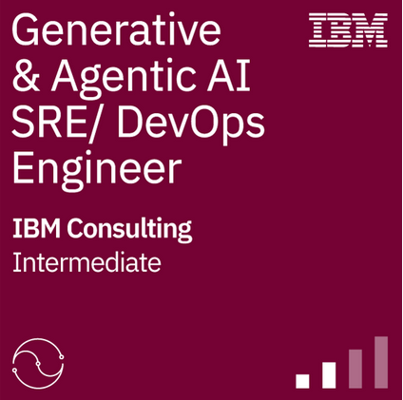
IBM Consulting Generative & Agentic AI Experienced Level SRE/DevOps Engineer
In this learning program you learned about:
Our “Client first….with a point of view” perspective, and how our technology and expertise are represented in our offerings and use cases
How to achieve greater value for our clients with IBM’s watsonx portfolio and Strategic Partner generative & agentic AI solutions
Bias, data accuracy, and risk of generative & agentic AI, and how we approach Trustworthy AI
Use of prompt engineering techniques and IBM Assistants to augment our own work, improving efficiency and effectiveness that delivers better, faster value to clients.
IBM methods, tools, and best practices in delivering generative & agentic AI solutions for our clients
You are now required to either A) record a short video between 7-10 minutes in length or B) complete a written application in which you will demonstrate your understanding of the material and your related skills. This may be achieved by:
Detailed description of client-based experience
If a video, demonstration of expertise in a simulated client situation (e.g., lab demo)
If a written application, description of your work products, deliverables, and applications delivered on a generative & agentic AI project
Completion of this either the video or the application is required for the IBM Consulting Generative & Agentic AI SRE/DevOps Engineer Intermediate badge.

Slide 3
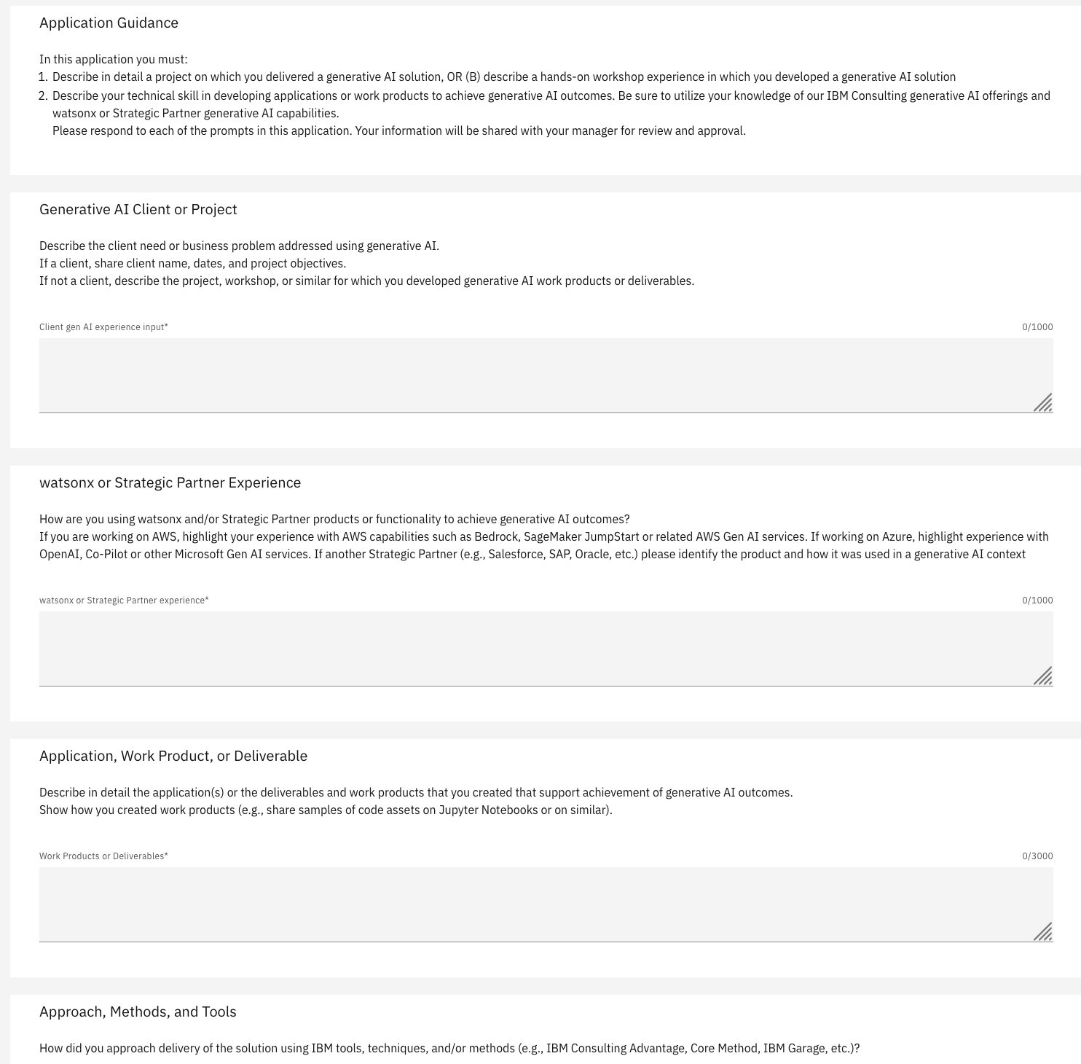
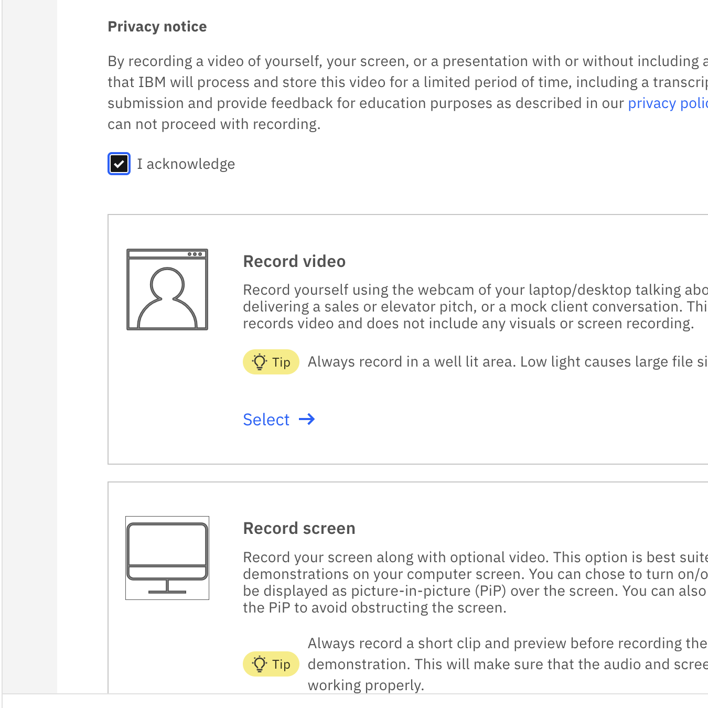
Options to Demonstrate Expertise & Eminence
A Stand & Deliver video should be 7-10 minutes in length
You are encouraged to use visual content to support your presentation (e.g., Powerpoint, demo of code, etc.)
You are not required to be on camera if you do not wish
Your video must cover all project experience requirements listed in this guide
The written application requires you to fully document your generative & agentic AI project experience on a project or internal program
Your application must cover all project experience requirements listed in this guide
Candidates for an Experienced-level badge may complete either:
A Stand & Deliver video
OR
A written application

Slide 4


To prepare for your Stand and Deliver video OR written application:
Prepare support materials that describe projects on which you delivered a generative & agentic AI solution(s).
Review the topics on this page to ensure that you have material that addresses these areas of evaluation
When ready, choose either the the “Stand and Deliver” activity OR the “Written Application” activity within the learning plan to record your pitch.
If you chose Stand & Deliver, you are not required to be on camera yourself; you may choose to show only presentation materials if you wish.
Your presentation should cover the following key topics, which will be assessed:
Description of the client need or business problem to be addressed using generative & agentic AI.
If a client, share client name, dates, and project objectives.
If not a client, describe your scenario for which you will demonstrate work products.
What is the relevant IBM generative & agentic AI offering you are enabling or supporting?
How are you using watsonx and/or Strategic Partner products or functionality to achieve the outcomes?
What is the solution or the deliverables and work products that you created that support achievement of generative & agentic AI outcomes?
Describe how you created work products and deliverables.
How did you approach delivery of the solution using IBM tools, techniques, and/or methods (e.g., IBM Consulting Advantage, Core Method, IBM Garage, etc.)?
What types of risks and ethical concerns exist, and how did you address these risks? You should describe how you used IBM's approach to Trustworthy AI, AI Ethics, and governance.

Slide 5
Guidance for Approvers
Common Submission Requirements
(written application or video)
Stand & Deliver Rating System
If applicants choose to use the Stand & Deliver approach:
Applicants are expected to achieve an average of 3 out of 5 stars on the Stand and Deliver rating system across the five areas.
Rating meters will be used to rate the Required Elements and the Supplemental Feedback.
The 5-star scale goes from 1 star (least) to 5 stars (best).
  1 star – The submission did not include the required content or meet expectations.
  2 stars – The submission includes some of the required content, and/or was below expectations.
  3 stars – The submission included a moderate amount of the required content and met expectations.
  4 stars – The submission included a high level the required content and exceeded expectations.
  5 stars – The submission included an exceptional amount of the required content and far exceeded standards.
Please judge the submission based on the Learner’s:
Demonstration of deliverables or work products that support a generative & agentic AI solution
Experience requirements that are specific to the Submitter’s role (e.g., Architect, Developer, etc.)
Inclusion of watsonx and/or Strategic Partner products
Use of IBM tools, techniques, methods, and/or best practices
Discussion of risks or ethical concerns, and how they were addressed
Please use the guidance provided to the Learner in the prior page to evaluate the video, confirming the Learner has met the required criteria.
IMPORTANT: Please assess the submission using expectations you would have for an Experienced Quality Engineer role.

